Slide 1

OPERATING SYSTEM
ADITYA COLLEGE OF ENGINEERING &
TECHNOLOGY
(Unit-2)
Inter-Process Communication

Slide 2
Inter-Process Communication
Aditya College of Engineering &
Technology
A process can be of two types:
Independent process.
Co-operating process.
An independent process is not affected by the execution of other processes while a co-operating process can be affected by other executing processes.
Inter process communication (IPC) is a mechanism which allows processes to communicate with each other and synchronize their actions.
The communication between these processes can be seen as a method of co-operation between them.
Processes can communicate with each other through both:
Shared Memory
Message passing

Slide 3
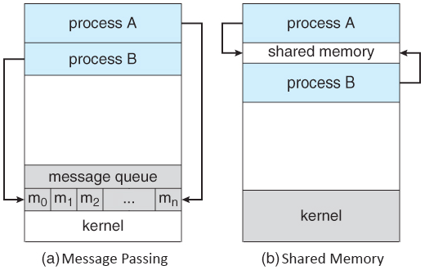
Aditya College of Engineering &
Technology

Slide 4
Aditya College of Engineering &
Technology
THANK YOU

